Slide 1
Predicting Ethereum’s cryptocurrency prices using Recurrent Neural Network (RNN)
Nhan Jimmy Nguyen
D.S Pathways

Slide 2
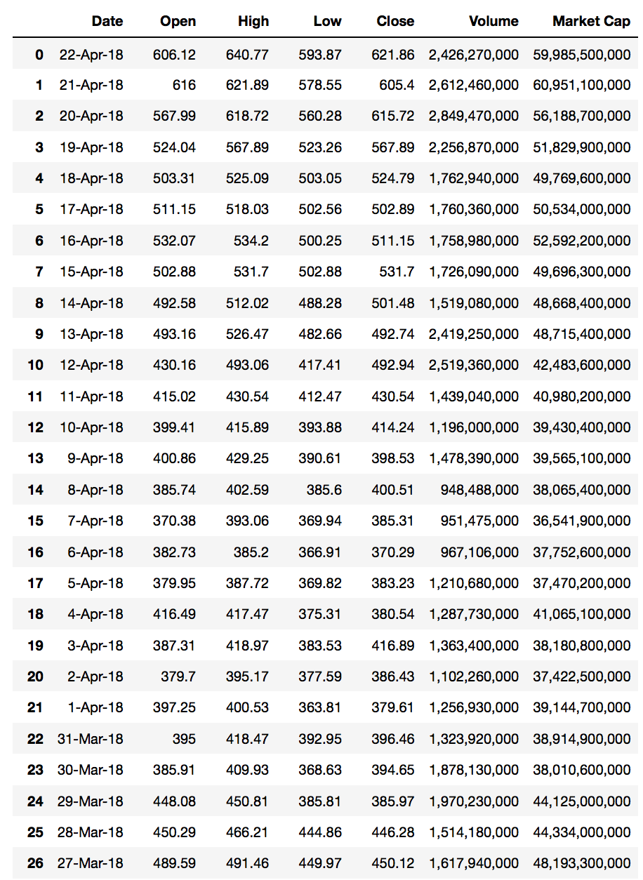
Our Dataset
We are interested in the closing value of each day because dealing with RNN involves sequence dependence data
(time-series prediction problem)

Slide 3
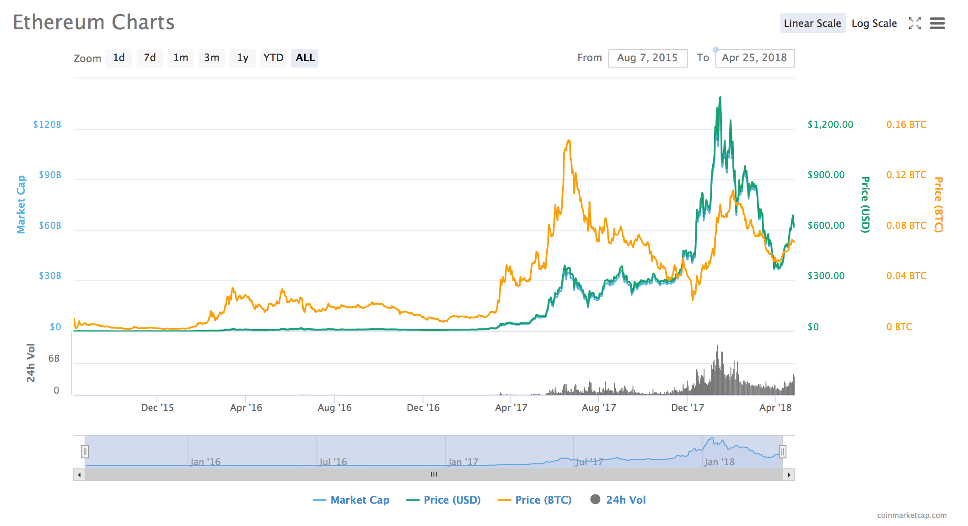
Ethereum Charts (Jan. 2016 ~ April 2018)

Slide 4
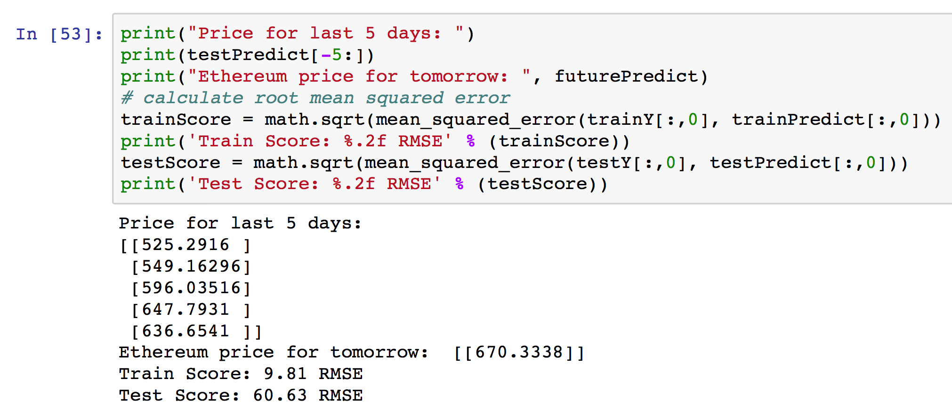
Building our neural network
The network has 1 input layer, a hidden layer with 4 LSTM blocks or neurons, and an output layer that makes a single value prediction.
After building our network and fitting our model, we were able to predict Ethereum’s price tomorrow based off of its’ closing values in the last 5 days.

